Slide 1


Content-Based Image Retrieval System for Museum Art
Master’s Degree in Computer Vision
C1 Course — Introduction to Human and Computer Vision
Team 1

Slide 2

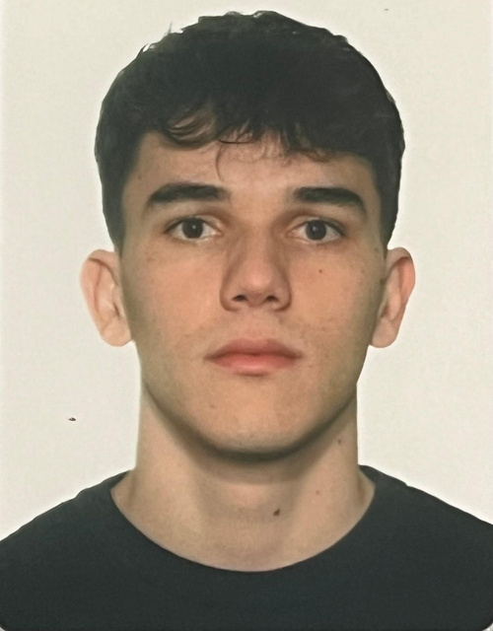
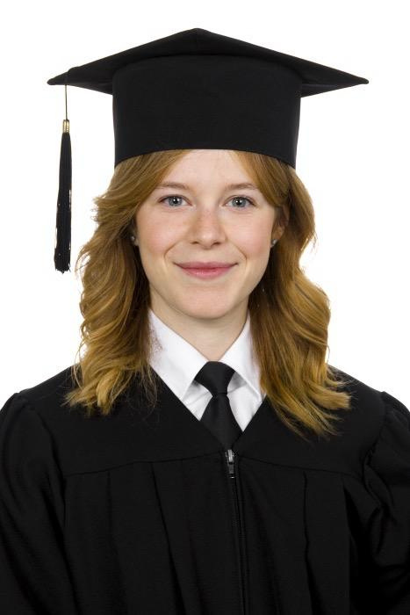
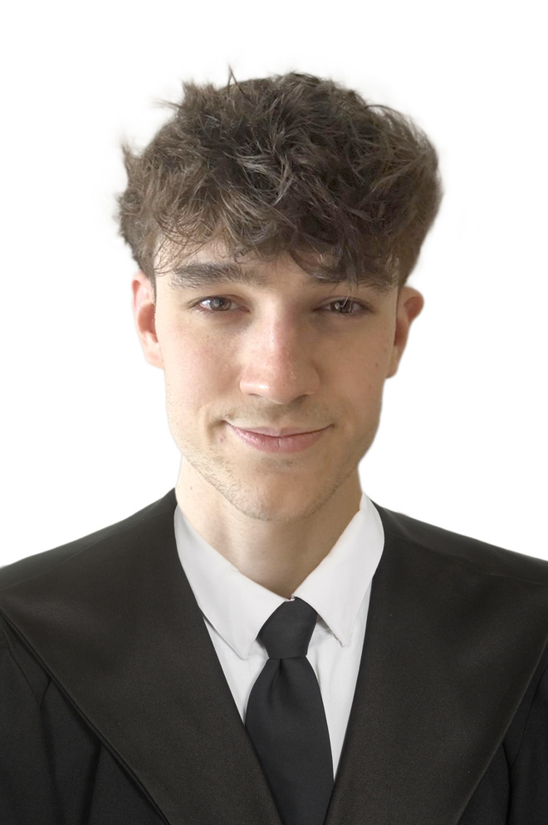
Team 1
Adrián García Tapia,
1568249
Maiol Sabater Oliveras,
1634564
Júlia Garcia Torné,
1630382
Gerard Vilaplana Pelegrí,
1776578

Slide 3
Group 1:
Gerard Vilaplana Pelegrí,
Adrián García Tapia,
Maiol Sabater Oliveras,
Júlia Garcia Torné
Global System Pipeline
Goal: Retrieve artworks in a museum database using visual similarity.
Input: Query set (QSD1-W4) and museum database images.
Output: Ranked list of most similar paintings for each query.
Load and preprocess images from the database and query sets
Apply masks to extract paintings from complex scenes
Detect and compute local features
Match query descriptors with database descriptors
Evaluate performance using MAP@K

Slide 4
Group 1:
Gerard Vilaplana Pelegrí,
Adrián García Tapia,
Maiol Sabater Oliveras,
Júlia Garcia Torné
Keypoint Detection and Descriptor Computation

Slide 5
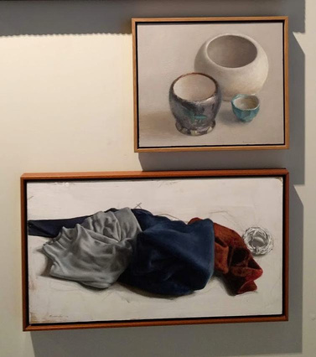
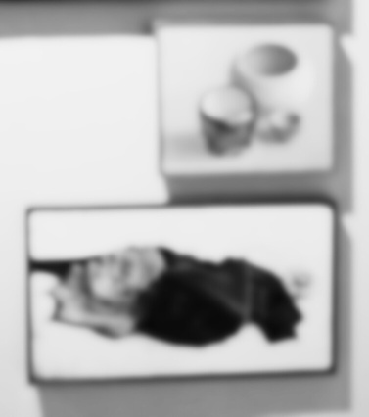

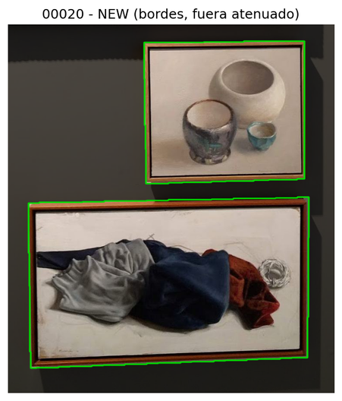
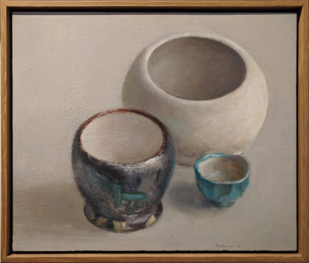
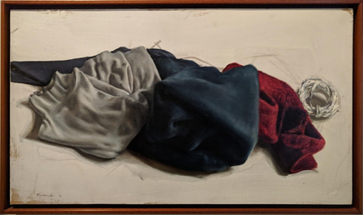
Group 1:
Gerard Vilaplana Pelegrí,
Adrián García Tapia,
Maiol Sabater Oliveras,
Júlia Garcia Torné
Dataset Loading and Preprocessing
Images are loaded as grayscale and resized to a maximum side of 512 pixels.
Gaussian blur applied before resizing to reduce aliasing.
Masks extracted from previous weeks are used to isolate paintings.
Connected components separate multiple paintings within one image.
Each detected painting is cropped, masked, and stored individually.
Original Image
Preprocessed Image
Extracted Mask
Mask Overlay
Extracted Individual Pictures

Slide 6

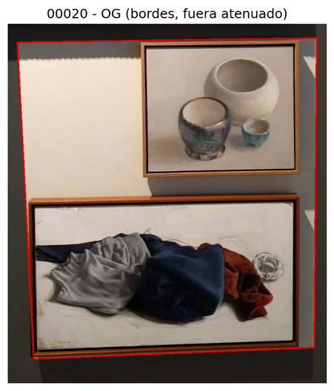
Group 1:
Gerard Vilaplana Pelegrí,
Adrián García Tapia,
Maiol Sabater Oliveras,
Júlia Garcia Torné
Mask Extraction
For this step, we used and adapted the Group 2 code to better fit our specific requirements by allowing the detection of both horizontal and vertical separations.
Before Modification
After Modification

Slide 7
Group 1:
Gerard Vilaplana Pelegrí,
Adrián García Tapia,
Maiol Sabater Oliveras,
Júlia Garcia Torné
Feature Detection and Description
Goal: Extract distinctive visual features from museum and query images.
Techniques tested:
SIFT (Scale-Invariant Feature Transform): detects distinctive keypoints robust to scale, rotation, and illumination changes.
ORB (Oriented FAST and Rotated BRIEF): a fast, rotation-invariant binary descriptor suitable for real-time applications.
AKAZE (Accelerated KAZE): extracts features in a nonlinear scale space, offering a good trade-off between accuracy and efficiency.

Slide 8
Group 1:
Gerard Vilaplana Pelegrí,
Adrián García Tapia,
Maiol Sabater Oliveras,
Júlia Garcia Torné
Image Matching and Retrieval Pipeline
Brute Force
Matcher
SIFT:
NORM_L2 NORM_L2SQR
ORB:
NORM_HAMMING NORM_HAMMING2
AKAZE:
NORM_HAMMING
Filter matches using Lowe’s Ratio Test
KNN (K=2)
Keep if:
1st match < ratio × 2nd match
Verify correctness
Cross-check matches
(DB ↔ Query)
using same Lowe ratio
Are there enough verified matches?
Apply a threshold to confirm if image exists in DB.
Retrieval
Retrieve the database images sorted by number of good matches.

Slide 9
Group 1:
Gerard Vilaplana Pelegrí,
Adrián García Tapia,
Maiol Sabater Oliveras,
Júlia Garcia Torné
Grid Search: Finding the Optimal Parameters

Slide 10
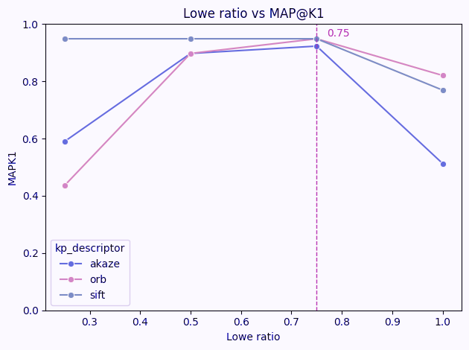
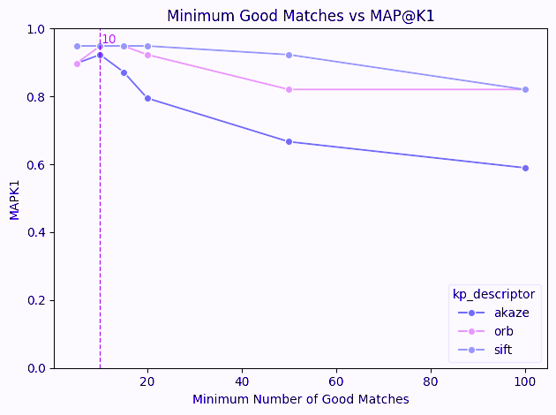
Group 1:
Gerard Vilaplana Pelegrí,
Adrián García Tapia,
Maiol Sabater Oliveras,
Júlia Garcia Torné
Matcher Parameters vs. MAP@K1

Slide 11
Group 1:
Gerard Vilaplana Pelegrí,
Adrián García Tapia,
Maiol Sabater Oliveras,
Júlia Garcia Torné
Optimal Descriptor Parameters
We performed a grid search to explore multiple combinations of descriptor parameters systematically.
Best descriptor setups:
ORB
WTA_K: 3
n_features: 500
scale_factor: 1.2
n_levels: 6
(...)
AKAZE
threshold: 0.0001
descriptor_size: 0
descriptor_channels: 3
(...)

Slide 12
Group 1:
Gerard Vilaplana Pelegrí,
Adrián García Tapia,
Maiol Sabater Oliveras,
Júlia Garcia Torné
System Evaluation (MAP@K)

Slide 13
Group 1:
Gerard Vilaplana Pelegrí,
Adrián García Tapia,
Maiol Sabater Oliveras,
Júlia Garcia Torné
Evaluation metric
MAP@K (Mean Average Precision) measures ranking performance.
High MAP@K → relevant database images retrieved at top positions.
SETUPS
RESULTS
ORB
WTA_K: 3
n_features: 500
scale_factor: 1.2
n_levels: 6
(...)
AKAZE
threshold: 0.0001
descriptor_size: 0
descriptor_channels: 3
(...)
MAP@K1: ≈ 0.974
Correct Predicted Paintings: 38/39

Slide 14
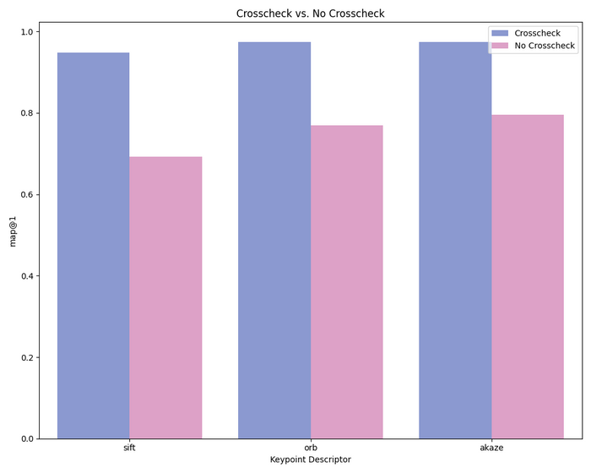
Group 1:
Gerard Vilaplana Pelegrí,
Adrián García Tapia,
Maiol Sabater Oliveras,
Júlia Garcia Torné
Results and Observations
Key Findings:
When it comes to AKAZE, lower ”threshold” → more meaningful keypoints and improved retrieval accuracy.
Image downscaling + Gaussian blur → remove noise and minor details, keeping only essential visual information.
By tuning the Lowe ratio and minimum good matches close to their optimal values, the grid search provides enough variance to achieve remarkably strong results.
As shown in the plot on the right, Crosscheck significantly improves retrieval performance.

Slide 15
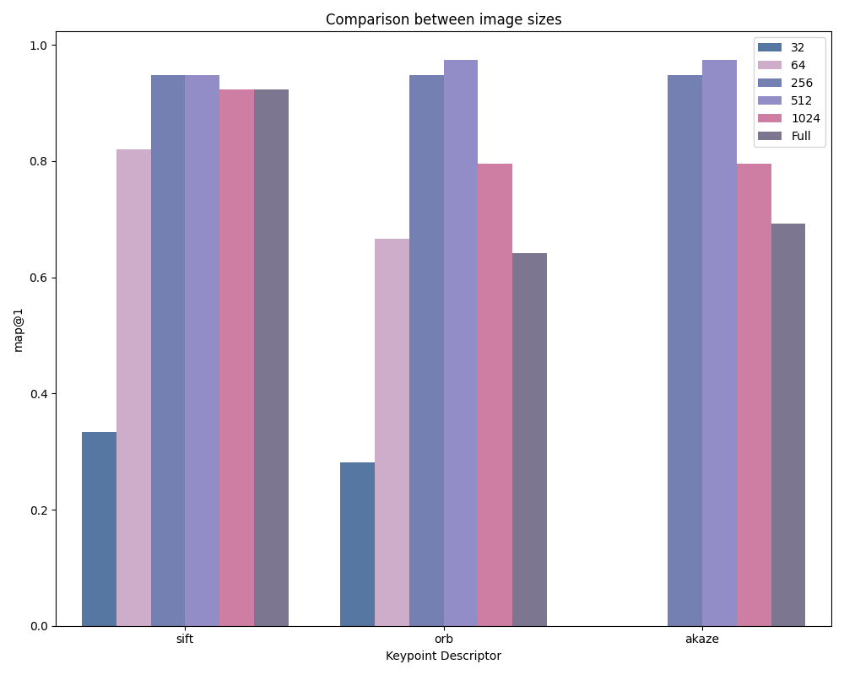
Group 1:
Gerard Vilaplana Pelegrí,
Adrián García Tapia,
Maiol Sabater Oliveras,
Júlia Garcia Torné
Results and Observations
Key Findings:

Slide 16
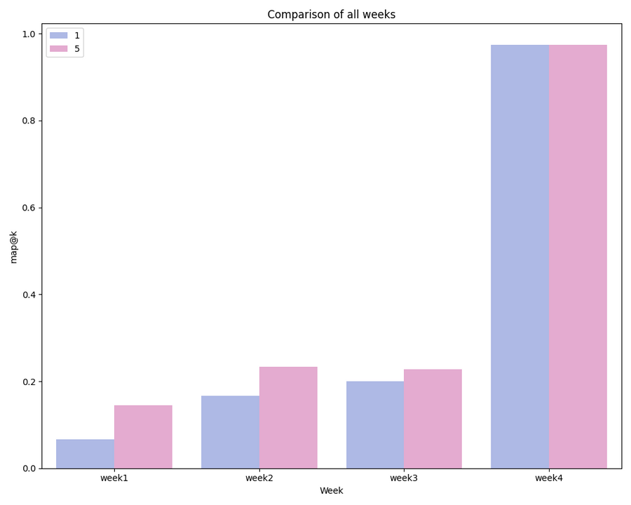
Group 1:
Gerard Vilaplana Pelegrí,
Adrián García Tapia,
Maiol Sabater Oliveras,
Júlia Garcia Torné
Results and Observations
Key Findings:

Slide 17
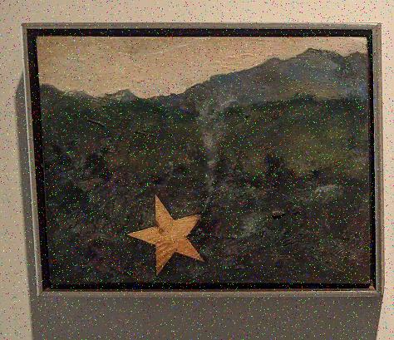

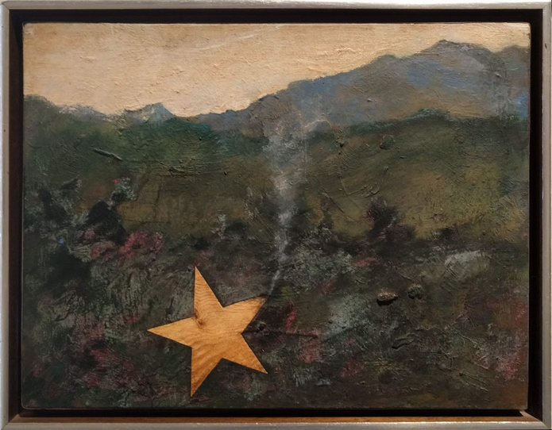
Group 1:
Gerard Vilaplana Pelegrí,
Adrián García Tapia,
Maiol Sabater Oliveras,
Júlia Garcia Torné
Results and Observations
Qualitative results
Query Image
Extracted Mask
Retrieved Image

Slide 18
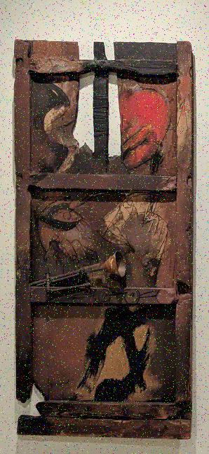

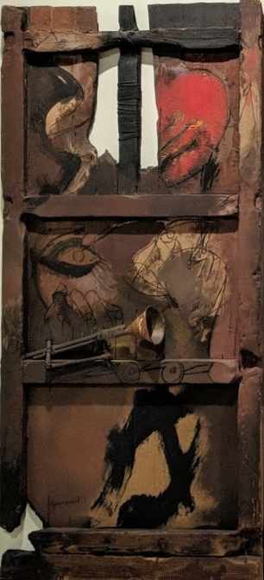
Group 1:
Gerard Vilaplana Pelegrí,
Adrián García Tapia,
Maiol Sabater Oliveras,
Júlia Garcia Torné
Results and Observations
Qualitative results
Query Image
Extracted Mask
Retrieved Image

Slide 19
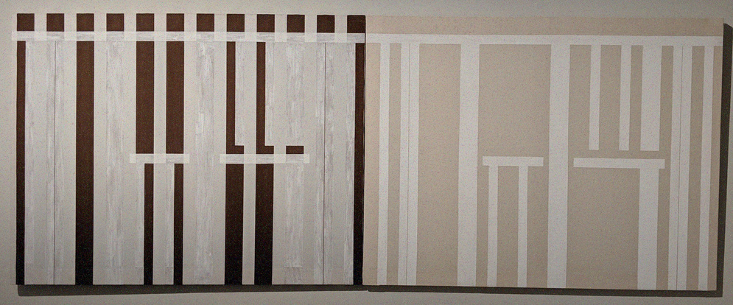


Group 1:
Gerard Vilaplana Pelegrí,
Adrián García Tapia,
Maiol Sabater Oliveras,
Júlia Garcia Torné
Limitations
The method is mask-dependent — if the mask fails, the descriptors also fail.
Incorrect masks lead to inaccurate feature extraction and matching.
Future work: explore deep learning–based segmentation methods to generate more accurate masks and improve overall robustness.
Original Image
Predicted Mask
GT Mask

Slide 20
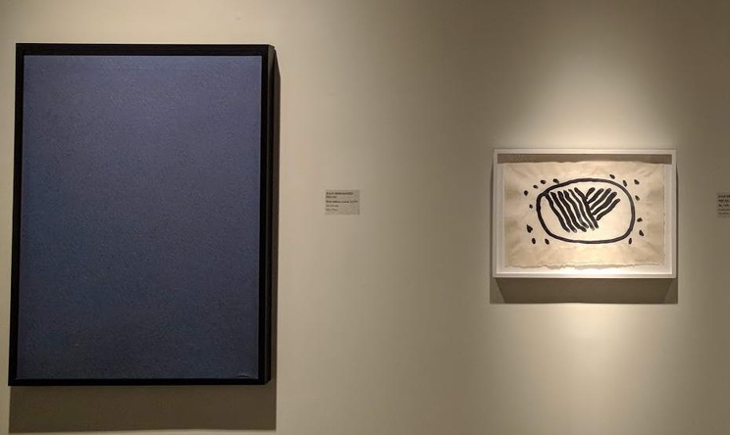

Group 1:
Gerard Vilaplana Pelegrí,
Adrián García Tapia,
Maiol Sabater Oliveras,
Júlia Garcia Torné
Limitations
When the painting surface is flat or lacks texture, feature detectors fail to identify keypoints. As a result, no reliable descriptors are generated, and matching becomes impossible. Blurry or uniform regions make comparison ineffective.
Future work: investigate feature extraction techniques robust to low-texture or uniform surfaces.
Problematic Samples

Slide 21
Group 1:
Gerard Vilaplana Pelegrí,
Adrián García Tapia,
Maiol Sabater Oliveras,
Júlia Garcia Torné
Conclusions
ORB and AKAZE achieve near-perfect MAP@K1 with optimal settings.
SIFT, while slightly less accurate, remains reliable and stable for retrieval.
Good matching conditions are more important than choosing the right detector.
The modified mask extraction method successfully isolates paintings in most cases.
The overall retrieval pipeline is robust and effective, despite minor limitations.

Slide 22
Group 1:
Gerard Vilaplana Pelegrí,
Adrián García Tapia,
Maiol Sabater Oliveras,
Júlia Garcia Torné
ANY QUESTIONS?

